Slide 1
CS 4102: Algorithms Lecture 1: Introduction and Logistics
Co-instructors: Robbie Hott and Tom Horton
Spring 2022

Slide 2
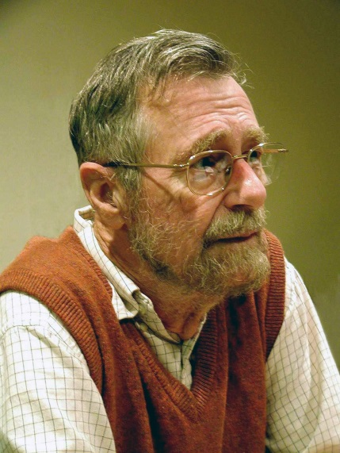
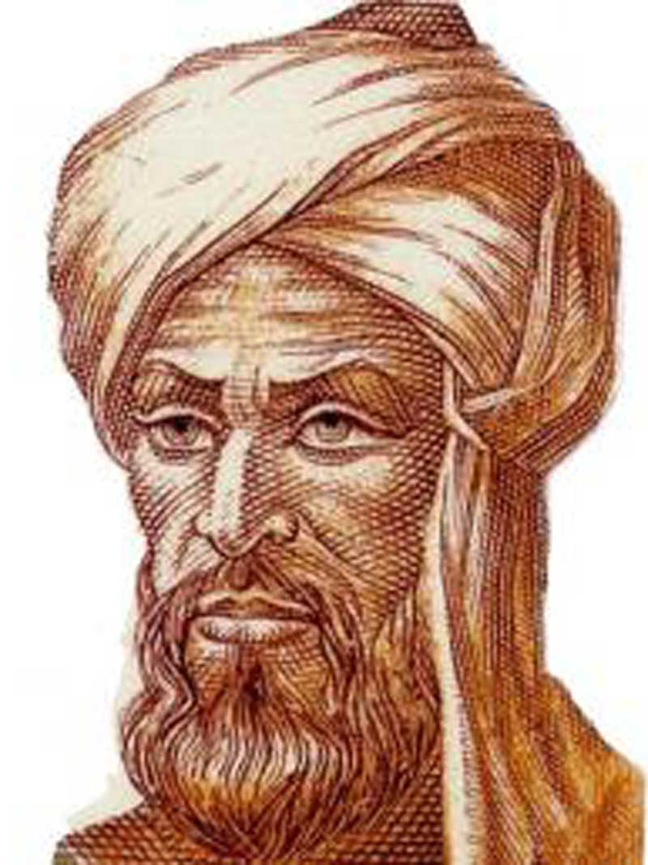
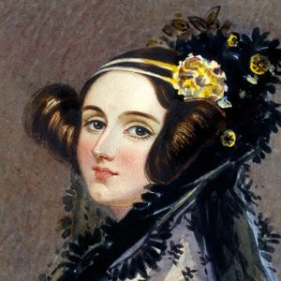
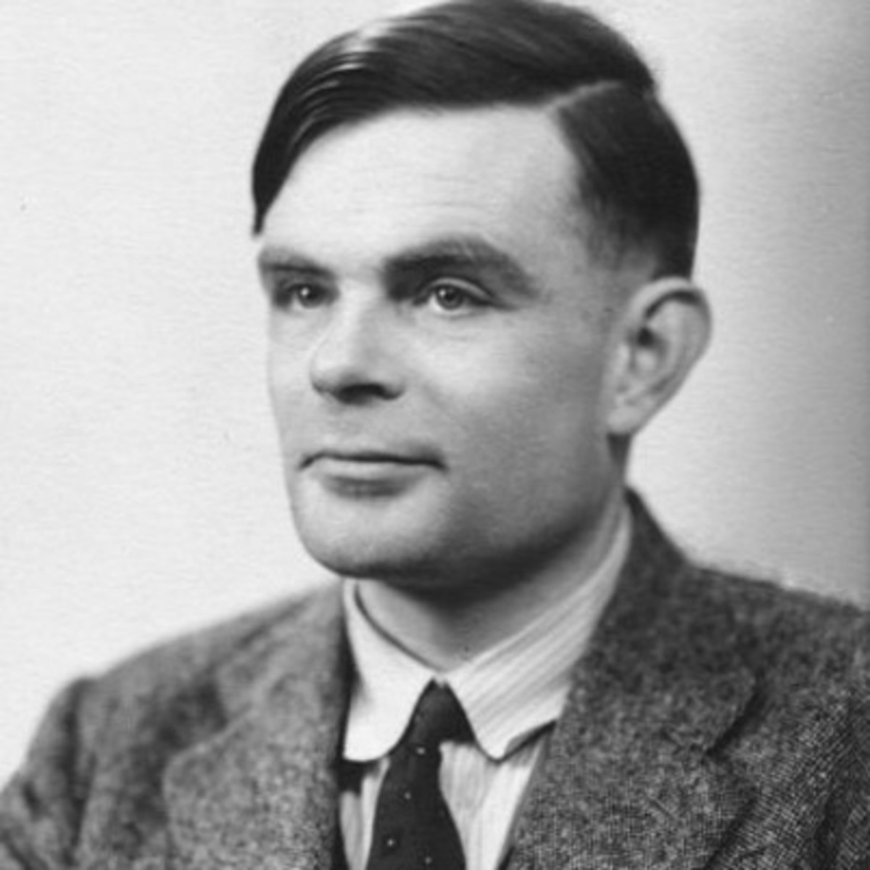
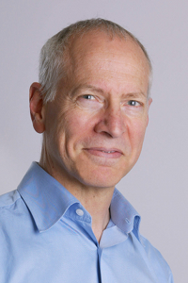

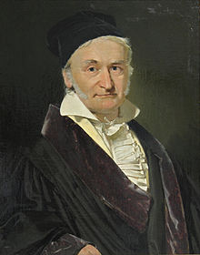
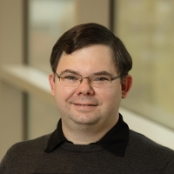
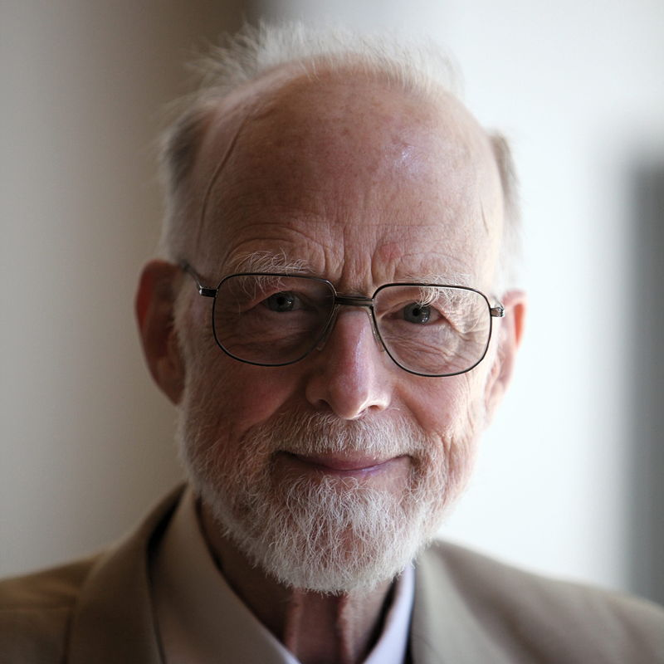
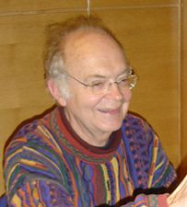
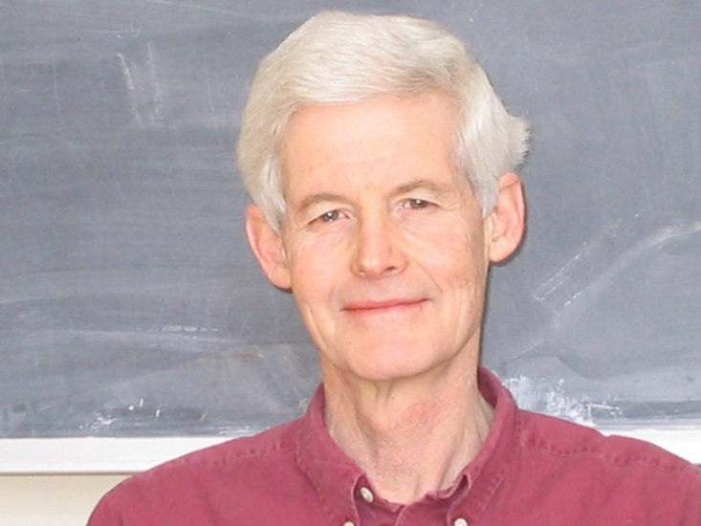
Who’s Who in Algorithms?

Slide 3
Who’s Who in Algorithms?
Edsger Dijkstra
Al-Khwarizmi
Alan Turing
Ada Lovelace
Tom Horton
Gauss
Robbie Hott
Robert Tarjan
Tony Hoare
Donald Knuth
Stephen Cook

Slide 4
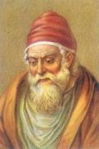
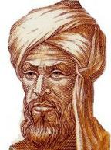





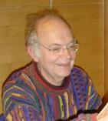
A Historic Perspective
Euclid
Al-Khwarizmi
Gauss
Ada Lovelace
Stephen Cook
300 BC
800
1600
1800
1900
Alan Turing
Edsger Dijkstra
Don Knuth
Notes:
Euclid – first algorithm (Euclidean algorithm for computing gcds)
Al-Khwarizmi – where the word “algebra” comes from, introduced positional number system (major improvement over systems like Roman numerals)
Gauss – mathematician (numerous contributions: e.g., Gaussian elimination)
Ada Lovelace – wrote the first computer algorithm for calculating Bernoulli numbers (for Babbage’s proposed general computer, the Analytical Engine)
Alan Turing – abstract models for computing
Stephen Cook – theory of NP hardness
Edsger Dijkstra – graph algorithms
Don Knuth – asymptotic notation, Art of Computer Programming

Slide 5
What Is an Algorithm?
In mathematics and computer science, an algorithm is a finite sequence of well-defined, computer-implementable instructions, typically to solve a class of problems or to perform a computation. Algorithms are unambiguous specifications for performing calculation, data processing, automated reasoning, and other tasks. [Wikipedia Jan 2020]
An algorithm is a step by step procedure to solve logical and mathematical problems. [Simple English Wikipedia Aug 2019]
Motivating example
Takeaway: Being unambiguous is not always easy!

Slide 6
Goals
Create an awesome learning experience
Instill enthusiasm for problem solving
Give broad perspective on computer science
Have fun!

Slide 7
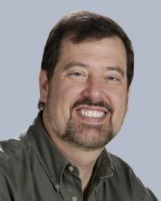
Co-Instructors
Prof. Hott
Rice 210
jrhott@virginia.edu Email or Piazza (no DMs in Discord)
Prof. Horton
Rice 401
horton@virginia.edu Email or Piazza (no DMs in Discord)
Office Hours TBD! Wait for announcement!
See course website for TA office hours

Slide 8
Logistics
Course website: https://uva-cs.github.io/cs4102-s22 Including syllabus, resources, slides, HWs, etc.
Also Collab for some things (e.g. lecture recordings)
Piazza for student questions? Yes, through Collab
Online office hours through Discord
Anonymous feedback? No….

Slide 9
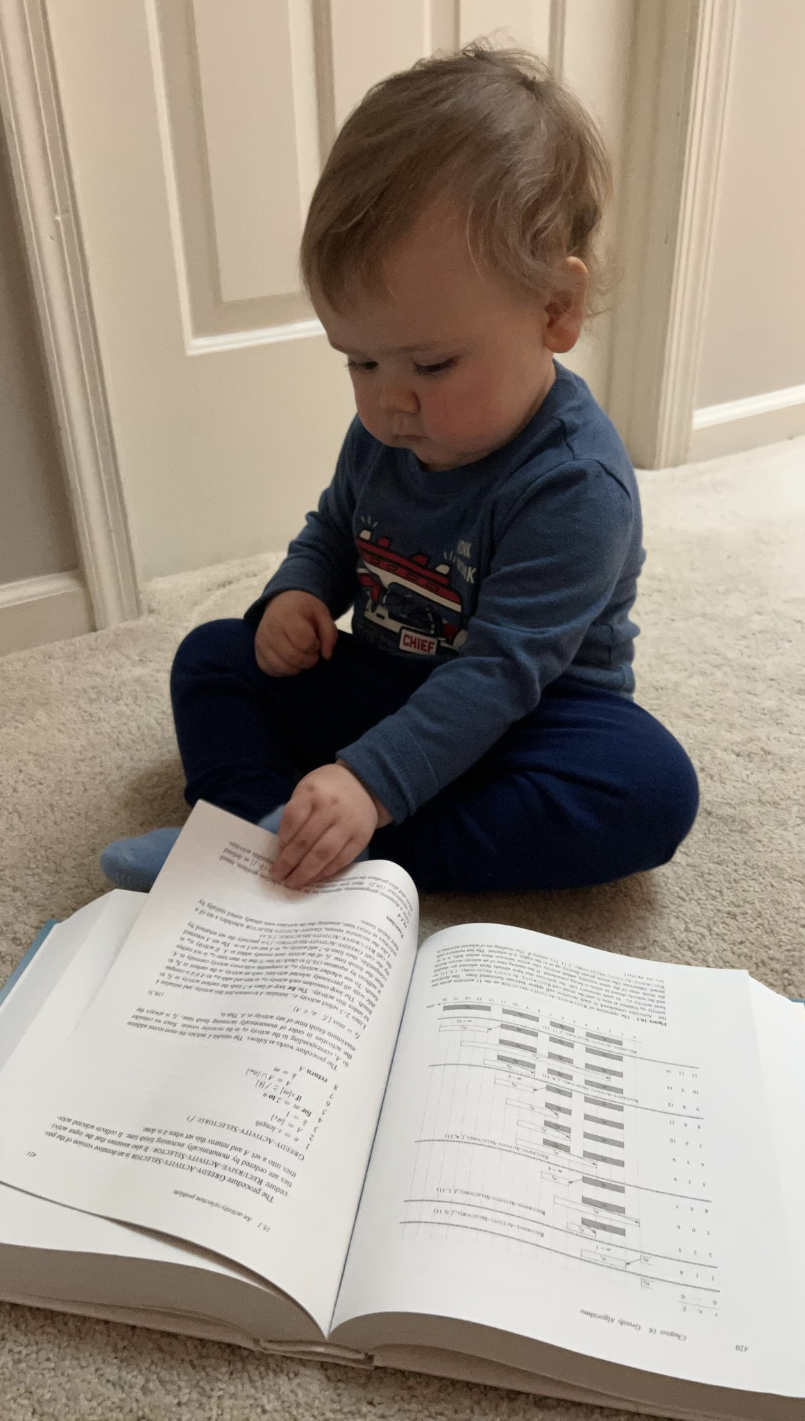
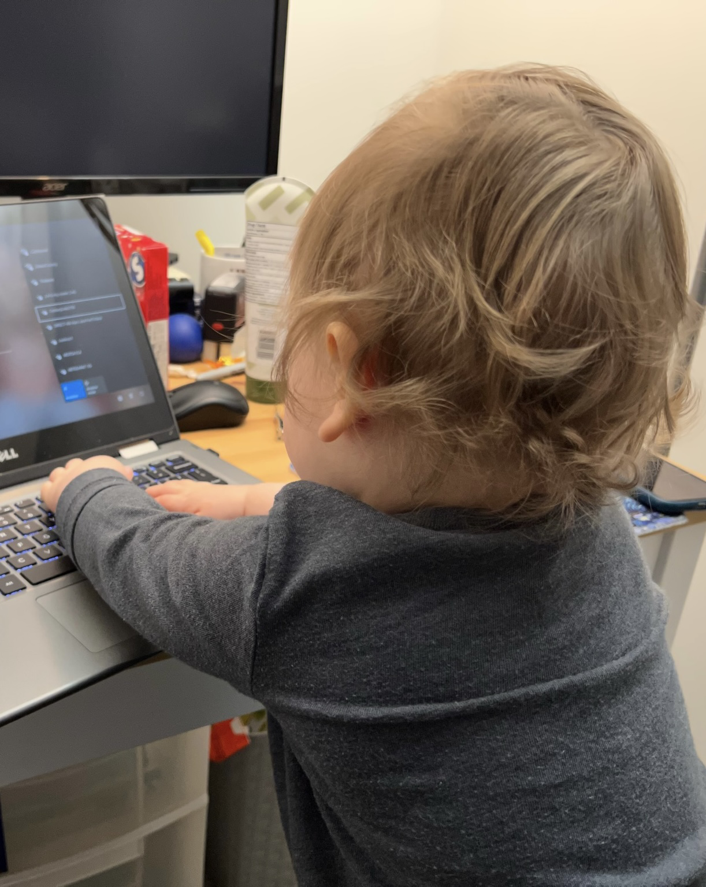
Covid-19 Course Modifications (Hott)
Modified Meeting Format (Hott’s section)
Online Synchronous on Zoom
Recordings posted to Panopto
Resume in-person: Feb 8
MEC 205
Notes:
Failure to mask will result in reporting to UJC and professionalism penalty

Slide 10
Covid-19 Course Modifications (Hott)
Following University Guidance in this course when meeting in person
Masks are REQUIRED in lecture
Masks will always be encouraged
All lectures recorded and posted
Hott’s office hours: on Zoom only (for now)
Notes:
Failure to mask will result in reporting to UJC and professionalism penalty

Slide 11
Covid-19 Course Modifications (Hott)
If you feel ill, please stay home
I will never take attendance
I will work with you—if you stay home—to ensure it does not affect your grade
If you are uncomfortable, you are welcome to stay home
I will work with you to ensure it does not affect your grade

Slide 12
Requirements
Discrete Math (CS 2102)
Data Structures (CS 2150) with C- or higher
Derivatives, series (Calc I)
Tenacity
Inquisitiveness
Creativity
Note: CS2150 pre-req taken seriously. Don’t meet it? Need approval or you will be dropped (after add deadline). ☹

Slide 13

Warning
This will be a very difficult class
Hard material
“Holy grail” of computer science
Useful in practice
Job interviews
Lots of opportunities to succeed!
I Quit!
Hopefully not you…

Slide 14

“Learning Sources”
From what sources will you learn?
What I say in Lectures
What you get from the slides
Explanations you read in CLRS
Activities you do in/out of class
Assignments
All of these are important.
Realistically, IMHO it’s impossible to get all the “book knowledge” from lectures and slides!

Slide 15
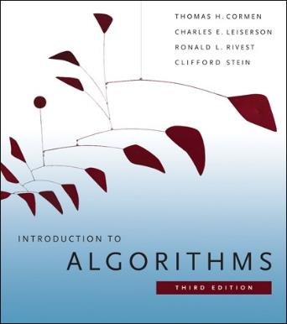
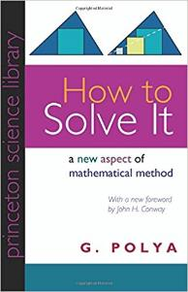
Textbook
You really need to read and study material other than the slides.
There are options, but a textbook is the easiest option.
I’ll post readings from CLRS, urge you to read them or get that info from another source. Note: We will also have some resources posted on Collab site.
Also recommended (but not a primary source)
Cormen et al. (CLRS) Introduction to Algorithms. 3rd Edition.
Polya. How to Solve It.

Slide 16
Textbook
You really need to read and study material other than the slides.
There are options, but a textbook is the easiest option.
I’ll post readings from CLRS, urge you to read them or get that info from another source. Note: We will also have some resources posted on Collab site.
Freely accessible online via the UVA library
Also recommended (but not a primary source)
Cormen et al. (CLRS) Introduction to Algorithms. 3rd Edition.
Polya. How to Solve It.
https://search.lib.virginia.edu/catalog/u6757775

Slide 17

Units and Assignments
Four Units:
Sorting, Recurrence Relations, Divide and Conquer
Graphs: Search, Minimum Spanning Trees, Shortest Paths
Dynamic Programming and Greedy Algorithms
Network Flow, Reductions, NP-Completeness
Each unit is 25% of your grade, broken down as follows:
Exam (13%)
Basic HW (2%) and Advanced Homework (5%)
Programming Assignment (5%)
Note: unlike last two semesters, each assignment gets a numeric score, and they’re combined to get an overall course score from 0-100.

Slide 18
Grade Components
Programs
20%
Exams 52%
Overview of these in the next slides. But see syllabus for full details!

Slide 19
Exams
In-person, in your assigned section’s classroom
Exams for Units A, B, and C can be re-taken! (Highest score counts)
See schedule on website for dates
Exam 1 is Feb. 22. (Re-take is two weeks later, after spring break)
Re-takes for Units B and C during Final Exam period
Only one chance for Unit D exam, during Final Exam period
In order to re-take an exam, you must have made a reasonable attempt on it the first time!

Slide 20
Basic Homeworks
Goal: Reinforce basic concepts and prepare you for exam
Due: Shortly before the exam (no extensions)
Format: Relatively short questions, nothing harder/longer than what’s on an exam
Grading: Three possible scores (100, 83, 0)
Feedback: Not much, but can submit up to two times before deadline.
Solutions will be posted right after the deadline.
Collaborate? Yes, in groups (more later)
Submissions must be formatted in LaTeX! (more later)

Slide 21
Advanced Homeworks
Goal: A small number of challenging problems, requiring more time and deeper thought
Due: After the unit’s exam (details TBD)
Grading: Graded more carefully than Basics HWs. Possible scores (100, 93, 83, 30, 0)
Feedback: Yes. Details on deadlines and possible resubmissions TBD.
Collaborate? Yes, in groups (more later)
Submissions must be formatted in LaTeX! (more later)

Slide 22
Programs
Goal: Explore one or more topics from a unit by applying and implementing it
Due: After the unit’s exam (details TBD)
Grading: Primarily based on passing test-cases on GradeScope. Possible scores (100, 93, 83, 30, 0), same as Advanced HWs.
Feedback: From GradeScope. Details on deadlines and possible resubmissions TBD.
Collaborate? Yes, in groups (more later)
Submissions can be in Python, Java, or C++

Slide 23
Basic Homework 1
Basic Homework 1A is out!
Learning LaTeX
Counts as one of the Basic HWs
Due right after the Add deadline (but don’t wait that long!)

Slide 24
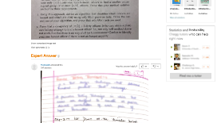
Academic Integrity
Collaboration Encouraged!
Groups of up to 4 per assignment (you + 3)
List your collaborators (by UVA computing ID)
OK to discuss problem, approach to solution, even details about solution, but…
Write-ups/code must be written independently
DO NOT share written notes / pictures / code
DO NOT share documents (ex: Overleaf)
DO NOT share debugging of code
Be able to explain any solution you submit!
DO NOT seek published solutions online
See syllabus about online code examples

Slide 25
Feedback
We professors are not course dictators, more like civil servants.
We’re open to any suggestion to help you learn.
Let us know!
In person
Piazza
Email: horton@virginia.edu or jrhott@virginia.edu
PLEASE: put CS4102 in subject line of all emails
(No Discord DMs, please)

Slide 26
A first algorithm: making change

Slide 27
OK… But What’s It Really All About?
Let’s illustrate some ideas you’ll see throughout the course
Using one example
Concepts:
Describing an algorithm
Measuring algorithm efficiency
Families or types of problems
Algorithm design strategies
Alternative strategies
Lower bounds and optimal algorithms
Problems that seem very hard

Slide 28
Everyone Already Knows Many Algorithms!
Worked retail? You know how to make change!
Example:
My item costs $4.37. I give you a five dollar bill. What do you give me in change?
Answer: two quarters, a dime, three pennies
Why? How do we figure that out?

Slide 29
Making Change
Problem:
Give back the right amount of change, and…
Return the fewest number of coins!
Inputs: the dollar-amount to return
Also, the set of possible coins. (Do we have half-dollars? That affects the answer we give.)
Output: a set of coins
Note this problem statement is simply a transformation
Given input, generate output with certain properties
No statement about how to do it.
Can you describe the algorithm you use?

Slide 30
A Change Algorithm
Consider the largest valued coin
How many go into the amount left?
Add that many of that coin to the output
Subtract the amount for those coins from the amount left to return
If the amount left is zero, done!
If not, consider next largest valued coin, and go back to Step 2
Notes:
Will this always finish? Yes, because we have pennies!

Slide 31
Is this a “good” algorithm?
What makes an algorithm “good”?
Good time complexity. (Maybe space complexity.)
Better than any other algorithm
Easy to understand
How could we measure how much work an algorithm does?
Code it and time it. Issues?
Count how many “instructions” it does before implementing it
Computer scientists count basic operations, and use a rough measure of this: order class, e.g. O(n lg n)

Slide 32
Evaluating Our Greedy Algorithm
How much work does it do?
Say C is the amount of change, and N is the number of coins in our coin-set
Loop at most N times, and inside the loop we do:
A division
Add something to the output list
A subtraction, and a test
We say this is O(N), or linear in terms of the size of the coin-set
Could we do better?
Is this an optimal algorithm?
We need to do a proof somehow to show this

Slide 33
You’re Being Greedy!
This algorithm is an example of a family of algorithms called greedy algorithms
Suitable for optimization problems
There are many feasible answers that add up to the right amount, but one answer is optimal or best (fewest coins)
Immediately greedy: at each step, choose what looks best now. No “look-ahead” into the future!
What’s an optimization problem?
Some subset or combination of values satisfies problem constraints (feasible solutions)
We have a rule to judge feasible solutions. One is best: the optimal solution

Slide 34
Does Greed Pay Off?
Greedy algorithms are often efficient.
Are they always right? Always find the optimal answer?
For some problems.
Not for checkers or chess!
Always for coin-changing problem? Depends on coin values
Say we had a 11-cent coin
What happens if we need to return 15 cents?
So how do we know?
In the real world:
Many optimization problems
Many good greedy solutions to some of these
Notes:
Use a funny name for the 11-cent coin. Name it after yourself, or call it a “Kardashian” or a Floryan or something.
If our set of coins contains a “Kardashian” plus the usual, then our algorithm will return first a Kardashian, then four pennies. Five coins. The best answer is a dime and a nickel, or two coins.

Slide 35
Formal algorithmic description
A full, formal description of an algorithm would have the following components:
Problem description (could be brief)
Inputs
Outputs
Assumptions
Strategy overview
Perhaps just 1 or 2 sentences outlining the basic strategy, including the name of the method you are going to use for the algorithm
Algorithm description
If listed in English (as opposed to pseudo-code), then it should be listed in steps

Slide 36
Change solution (greedy)
Problem description: providing coin change of a given amount in the fewest number of coins
Inputs: the dollar-amount to return. Perhaps the possible set of coins, if it is non-obvious.
Output: a set of coins that obtains the desired amount of change in the fewest number of coins
Assumptions: If the coins are not stated, then they are the standard quarter, dime, nickel, and penny. All inputs are non-negative, and dollar amounts are ignored.
Strategy: a greedy algorithm that uses the largest coins first
Description: Issue the largest coin (quarters) until the amount left is less than the amount of a quarter ($0.25). Repeat with decreasing coin sizes (dimes, nickels, pennies).

Slide 37
Another Change Algorithm
Give me another way to do this?
Brute force:
Generate all possible combinations of coins that add up to the required amount
From these, choose the one with smallest number
What would you say about this approach?
There are other ways to solve this problem
Dynamic programming: build a table of solutions to small subproblems, work your way up

Slide 38
Change solution (brute-force)
Problem description: providing coin change of a given amount in the fewest number of coins
Inputs: the dollar-amount to return. Perhaps the possible set of coins, if it is non-obvious.
Output: a set of coins that obtains the desired amount of change in the fewest number of coins
Assumptions: If the coins are not stated, then they are the standard quarter, dime, nickel, and penny. All inputs are non-negative, and dollar amounts are ignored.
Strategy: a brute-force algorithm that considers every possibility and picks the one with the fewest number of coins
Description: Consider every possible combination of coins that add to the given amount (done via a depth-first search). Return the one with the fewest number of coins.

Slide 39
Motivating problems

Slide 40
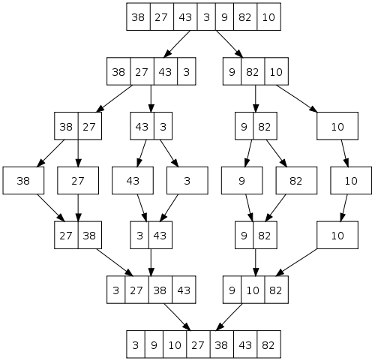
Motivating problem: Sorting
How do you implement a general-purpose sort that is as efficient as possible in both space and time, and is stable?
One solution is mergesort
We’ll see later why quicksort, heapsort, and radix sort are not sufficient
This is an application of both sorting and divide and conquer

Slide 41
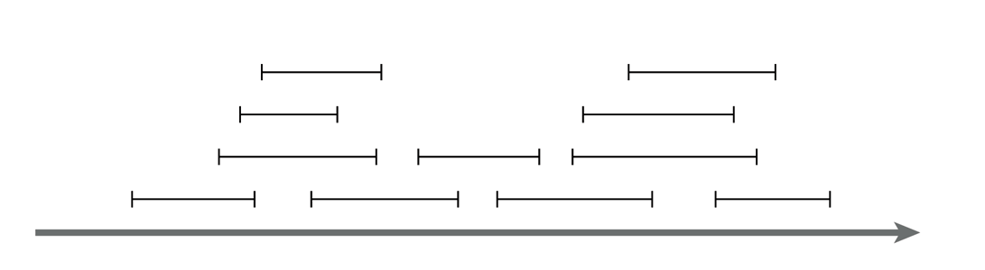
Motivating problem: Interval scheduling
Interval scheduling
Given a series of requests, each with a start time and end time, maximize the number of requests scheduled
This is solved by a greedy algorithm
Most of the CS 2150 algorithms you’ve seen are greedy algorithms: Dijkstra’s shortest path, both MST algorithms, etc.

Slide 42
Motivating problem: Weighted interval scheduling
Weighted interval scheduling
Same as the regular interval scheduling, but in addition each request has a cost associated with it
The goal is to maximize the cost from scheduling the items
This is solved by dynamic programming

Slide 43
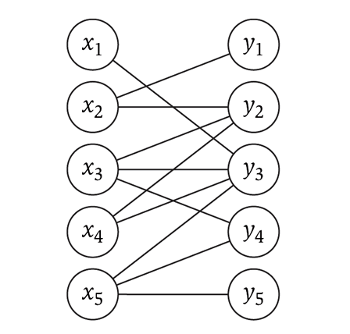
Motivating problem: Bipartite matching
Bipartite matching
Given a graph G, find the maximum sub-graph of G that partitions G into sets X and Y such that no node from X is connected to a node in Y, and vise-versa
Example: given a series of requests, and entities that can handle each request (such people, computers, etc.), find the optimal matching of requests to entities
This is a network flow problem

Slide 44
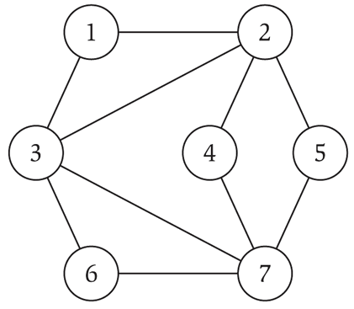
Motivating problem: Independent set
Independent set
Given a graph G, find the maximum size subset X of G such that no two nodes in X are connected to each other
This is a NP-complete problem
You’ve seen TSP (travelling salesperson problem) in CS 2150, which is a NP-complete problem

